Slide 1
Crime Data Analysis
&
Potential Factors
by
Joanna Layton
Ju A Han
Lakshmi Rangam
Marlene Vasquez

Slide 2
Crime in the US- what gives?
Inquiry and Inference:
What influences crime? Is there a correlation between voting trends and crime rates? What other factors may be making an impact on crime? Does this translate to an individual state?
Our initial assumptions were that we would notice:
A relationship between crime rates and voting trends by party affiliation
Violent crime rates would be more prominent in blue states
Property crime rates would be higher in red states
A correlation between hate crimes and violent crimes
Additionally, we theorized unemployment rates would have an effect on crime rates, specifically violent crime rates.
Findings:
Ideally, more data and time would have been useful, however, we were able to answer our initial questions and found we were correct to some degree and were surprised in other findings.
Crime rate by party affiliation did show a trend, although it was only half as expected with our property crime theory
Our findings with hate crime and unemployment rates however proved there was not a strong relationship between the two and violent crime rates or property crime rates.
Notes:
In order to try and solve or at least mitigate crime in the US, we must first understand how it starts by asking the initial questions and setting the groundwork for further analyzation and exploration.
There are many underlying issues when it comes to this problem, however, we feel starting with these questions is the best route for initial inquiry.
We were in agreement that the data we found would lead us to ask other helpful questions and provide a roadmap for future study.
Using the concept of data analytics we can extract useful information from unstructured data. Instead of focusing on causes of crime occurrence we are focusing mainly on potential crime factors, specifically the most current data available, data from the year 2018.For this analysis we used data visualization tools- Pandas, Matplotlib, and Plotly- to aid us in our exploration and data manipulation.

Slide 3
Data Exploration
We broke up our data gathering in three main groups and started with the data that would encompass the majority of our study, the crime data and went down the list.
We started out by researching crime data in general and from here landed on our two main crime types we would be exploring- violent crime and property crime. We used the definition of the FBI for what constitutes a violent crime and a property crime.
https://www.fbi.gov/services/cjis/ucr
Next we set out to find the data regarding state party affiliation per voting trends.
https://cookpolitical.com/pvi-0
https://worldpopulationreview.com/states/blue-states/
https://news.gallup.com/poll/226556/state-partisanship-shifts-toward-democratic-party-2017.aspx
https://www.sos.state.co.us/pubs/elections/VoterRegNumbers/VoterRegNumbers.html
https://www.census.gov/data/datasets/time-series/demo/popest/2010s-counties-total.html
Unemployment rates was the last dataset we needed to cover. We found the information for each state as well as for our Colorado state comparison at the US Bureau of Labor Statistics website.
https://www.bls.gov/lau/lastrk18.htm
Notes:
We knew that there are many factors that go into determining what causes a crime as well as nuances in what a crime can be or how it is reported. Our goal was to set a foundation that could be build upon for further study. We decided to look at the 50 states and break down their crime data by two subsets- violent crime and property crime. We added hate crime out of curiosity given the factors we would be exploring.
Crime Data: To keep our data consistent, we gathered all our crime information from the FBI’s uniform crime reporting website. For our individual state data, some counties crime data was missing. The data used for our Colorado analyzation only includes those counties for whom we had full data.
Voting and party affiliation: We used voting trends from presidential races, as well as house and senate races for the states and added gubernatorial races for our county data.

Slide 4
Definitions
Red State- a state whose voters predominantly choose candidates from the Republican party.
Blue State- a state whose voters predominantly choose candidates from the Democratic party.
Purple State- a purple state, also known as a swing state, refers to a state that could reasonably be won by either the Republican or Democratic party by a swing in votes.
Property Crime- property crime includes the offenses of burglary, larceny-theft, motor vehicle theft, and arson. The object of the theft-type offenses is the taking of money or property, but there is no force or threat of force against the victims.
Violent Crime- Violent Crime is composed of four offenses: murder and nonnegligent manslaughter, rape, robbery, and aggravated assault. Violent crimes are defined in the UCR Program as those offenses that involve force or threat of force.
Hate Crime- a criminal offense against a person or property motivated in whole or in part by an offender’s bias against a race, religion, disability, sexual orientation, ethnicity, gender, or gender identity.
Data Collection- The data presented in Crime in the United States reflect the Hierarchy Rule, which requires that only the most serious offense in a multiple-offense criminal incident be counted. In descending order of severity, the violent crimes are murder and nonnegligent manslaughter, forcible rape, robbery, and aggravated assault, followed by the property crimes of burglary, larceny-theft, and motor vehicle theft.

Slide 5
Uh-oh...now what?
Does a states adoption (or lack thereof) of a Victim Rights Amendment have an affect on these trends?
This was originally one of the questions we posed. We gathered the needed info and found ourselves interested in the data but not seeing the connection between our main question of crime rate and influences. This was something that our foundation could be used to explore at another time, but it did not tie into our present end goal.
Back to the drawing board…
Instead of analyzing another potential factor, we decided to delve a bit deeper and see if our correlations (or lacking relationships) translated to an individual state in the same way. What better state to review a bit more than the state of Colorado?
Notes:
We had a great and interesting thought...unfortunately, we realized it was not directly inline with our core message and question. However, it is one of the continuing factors that could be looked into and used to build upon the data we have and the analysis we completed. VRA’s in the States became much more complicated than we had initially anticipated and the more we discovered, the more we realized it was a complex notion of its own that required much more data than we originally thought and posed many more questions that were outside our scope.

Slide 6

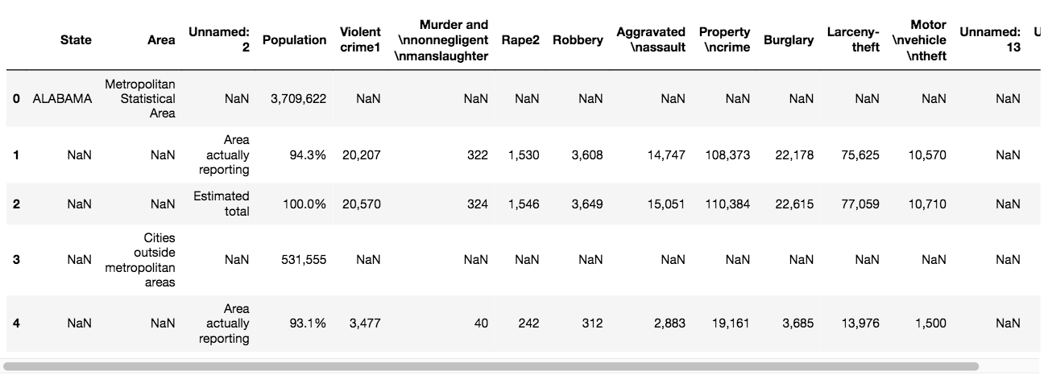
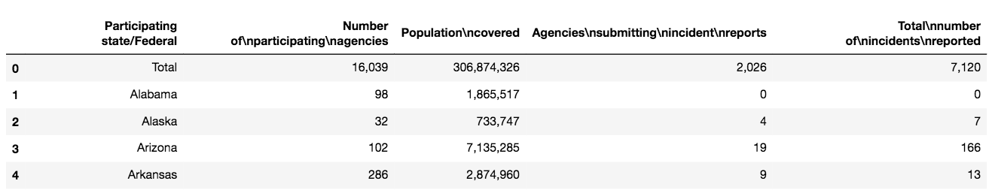
Cleanup, Cleanup...
Data does not always come in a form that is immediately suitable for analysis. One of the “messier” datasets to tidy up was our crime data.
Notes:
We often have to tidy up and reorganize data before analysis. We pulled several datasets from several different sites and had to clean the data for efficient use and to our liking for this specific analysis. Both our county crime data for Colorado and our overall US crime data were not an easy read when first displayed.
We removed unnecessary data and NaNs, dropped unneeded information, set conversions for our rates, and changed objects to floats more times than we can count.

Slide 7
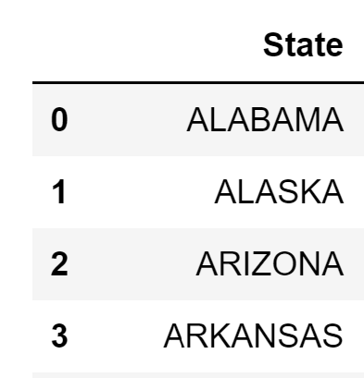
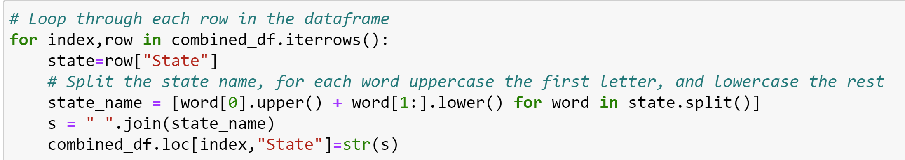
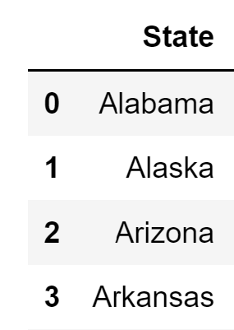
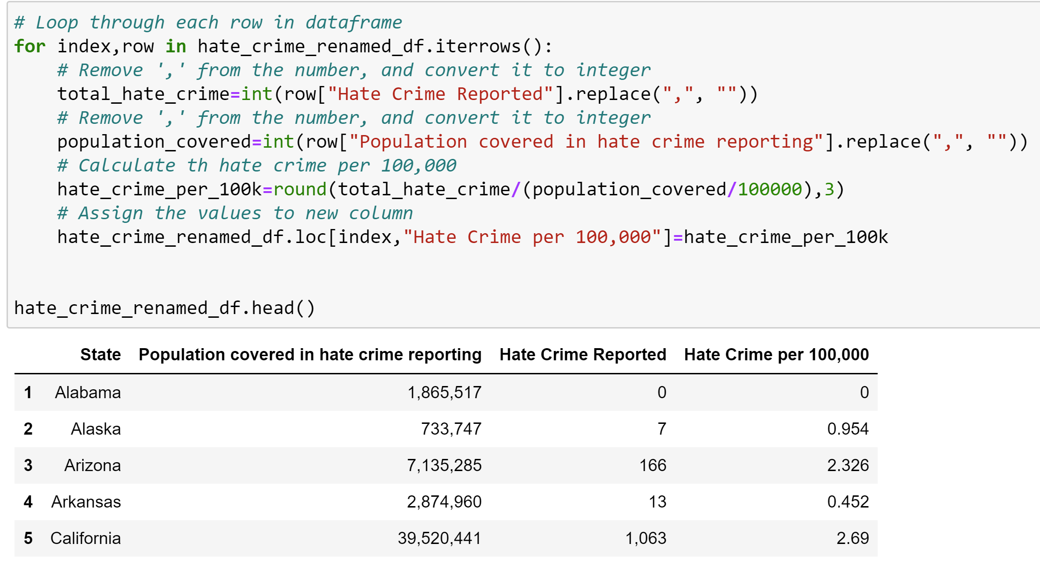
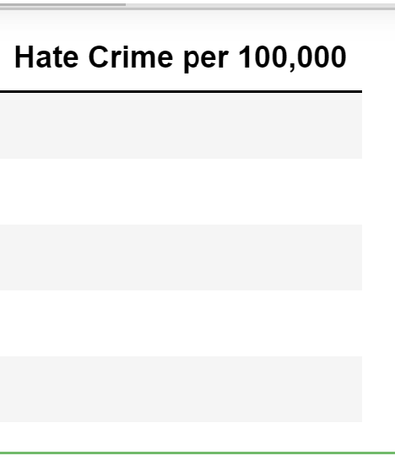
Cleanup Process
Some uses::
dataframe.rename()
dataframe.drop()
dataframe.loc()
dataframe.replace()
dataframe.rank()
pd.merge()
dataframe.split()
A lot of our cleanup involved having to manipulate the data to be used on a grand scale.
We adjusted the state names for readability as well as to be able to merge with the rest of our datasets.
We needed to convert out hate crimes into rates to even the score.
Before doing this, we had to convert our columns into integers and remove any separating commas.

Slide 8
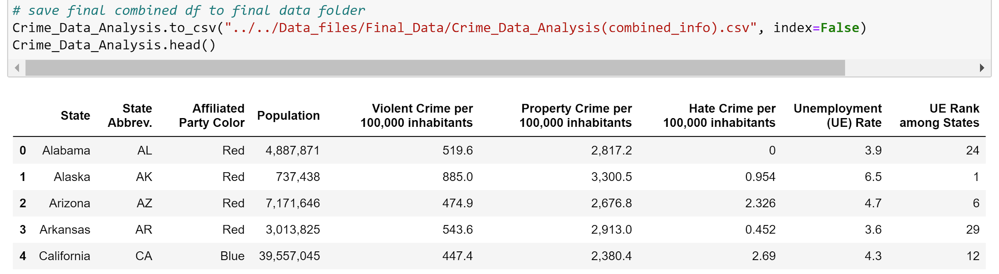
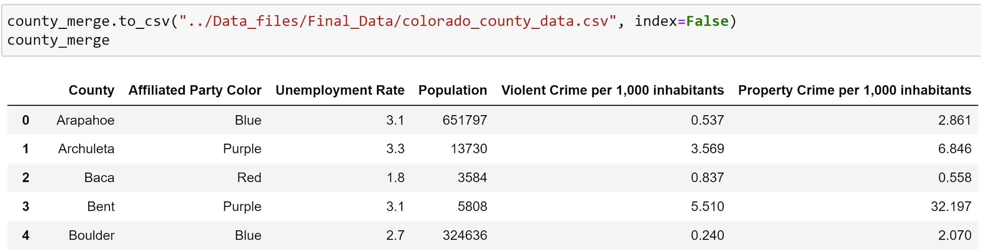
Analysis & Discovery
After cleaning up and manipulating the data, we merged our state data into a final csv for easier reading.
We saved separate csv’s containing the remaining data, but decided to keep only the data we would be comparing in the final table for efficiency.
Notes:
We gathered a lot of data from multiple sources, in order to answer our base question and start a foundation for our analysis, we needed to have the cleanest dataset with only the information we would be using. After breaking down the date and reviewing it as we went along, we landed on the tables you see above. We saved these tables into a final csv for use in our visualizations and comparisons.

Slide 9
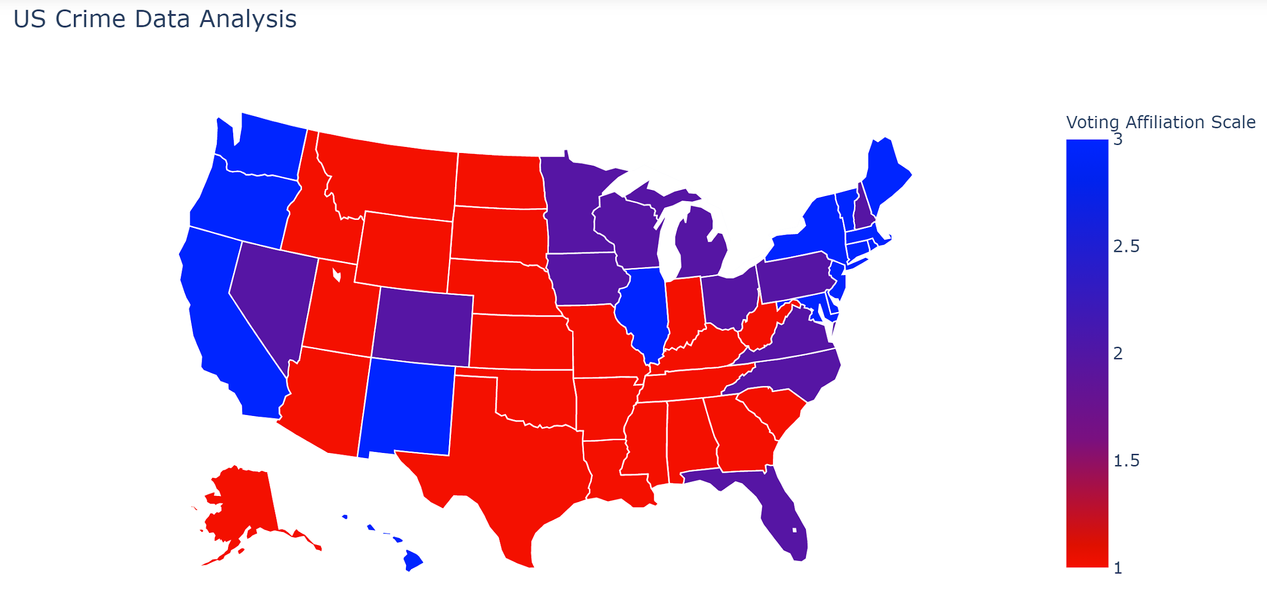
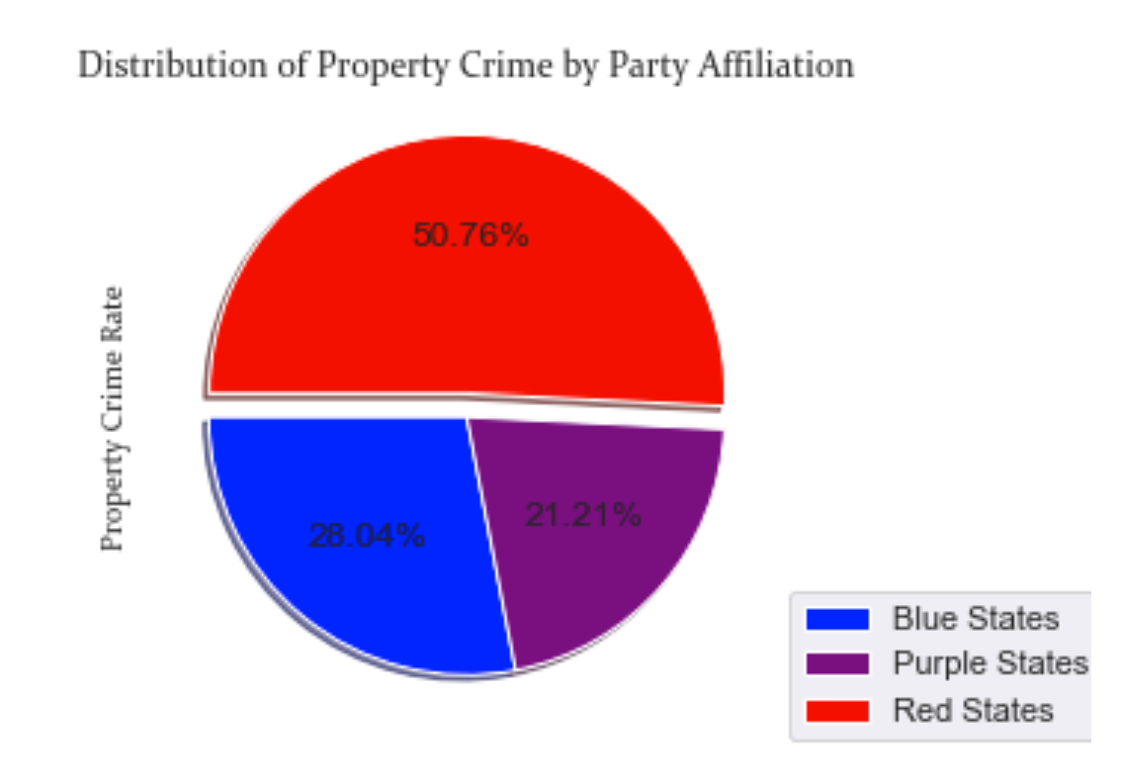
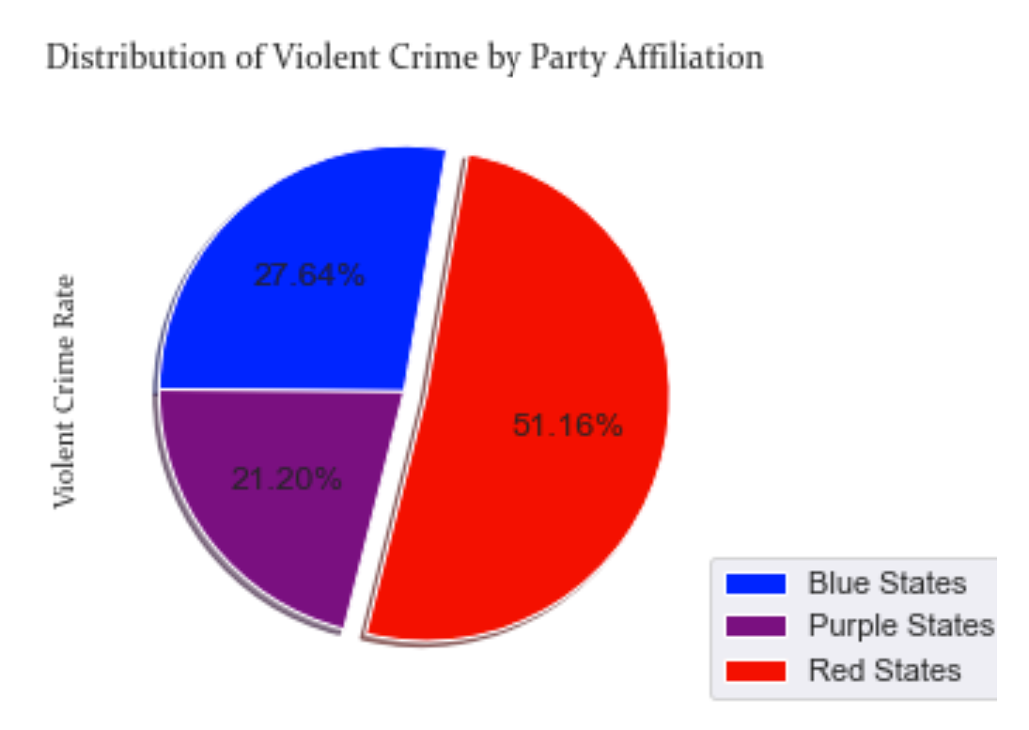
Does your state swing?
Take a look at our map of the US to see how each state tends to affiliate politically. We did notice a slight trend in crime rate per party affiliation. Although our initial hypothesis was not correct for violent crime rate, we did correctly determine that property crime rate is higher in red states.
Notes:
One discovery, regardless of our initial thoughts, is that red states tend to have both higher violent crime rates and property rates. This definitely poses the question as to why republican leaning states? What policies are they passing or not passing? What type of programs are blue and purple states promoting or what laws are they enforcing that are potentially making this difference?

Slide 10
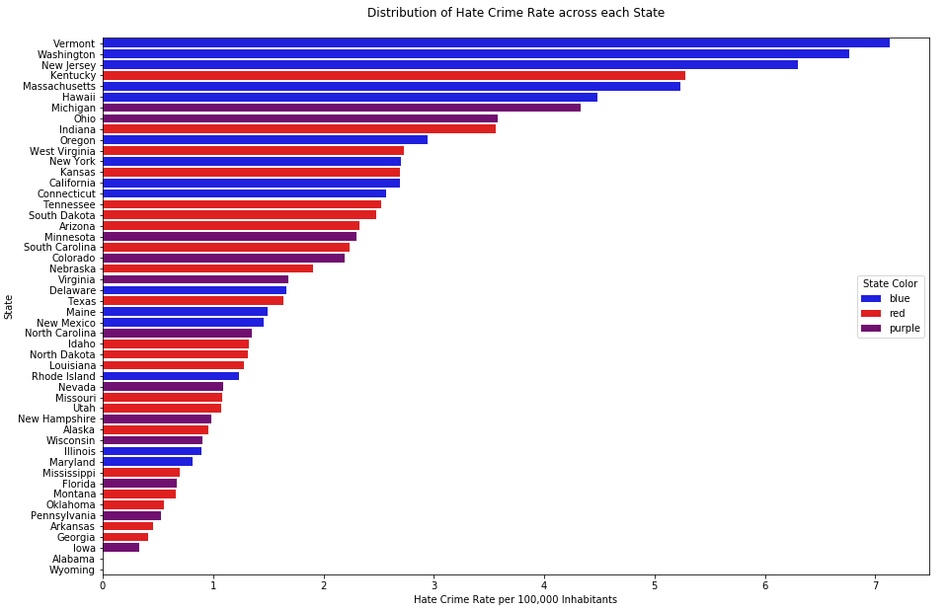
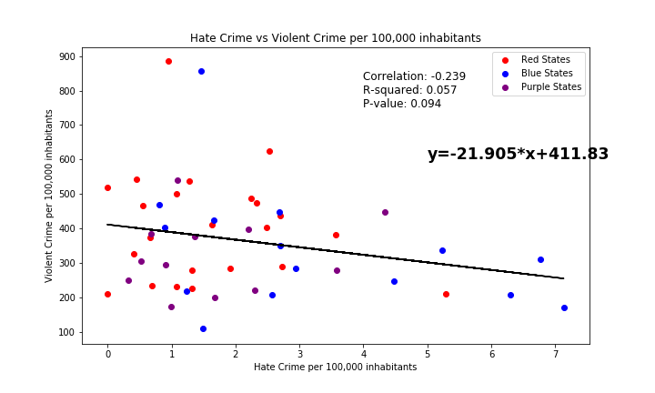
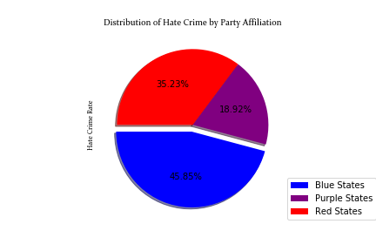
Do hate crimes differ?
At first glance of the bar chart below it appears as though hate crimes are lowest in red states and highest in blue states. A look at the pie chart would confirm this notion, but if we take a closer look at the y-axis of the bar chart, specifically the bottom containing the lower reporting states, questions are raised...
We also notice what seems to be a non-existent relationship between violent crime rate and hate crimes. Our assumption was that there would be a connection between the two, but we were surprised to see such a weak correlation.
Notes:
Missing information does not necessarily mean bad data, more so when the sources used are reputable government agencies. However, what happens when the issue is biased-related and dependent on how the reporting agency documents such crimes? Or if they report them at all? The lack of reports in two states and the low reporting across many states begs the question- could hate crime play a bigger role in crime than what bare numbers can tell?

Slide 11
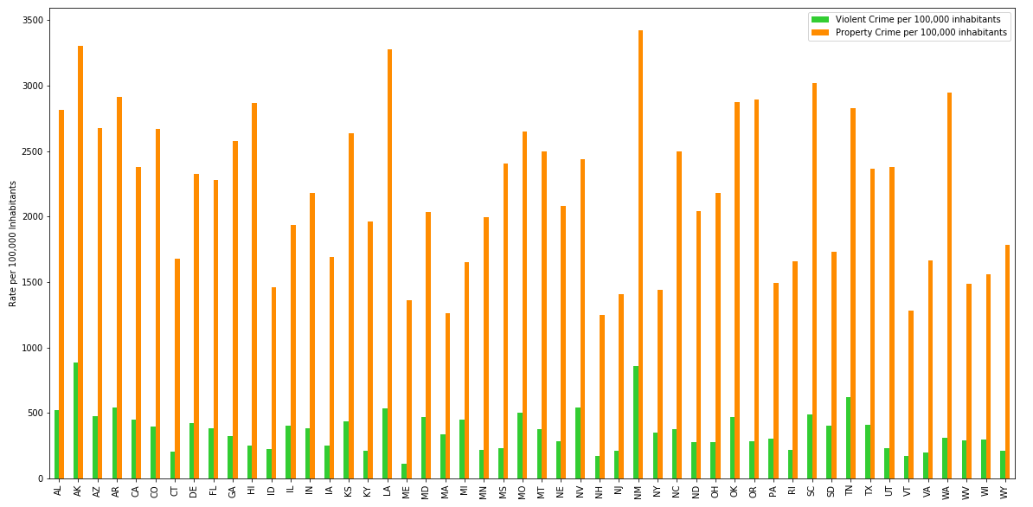
How do the crimes compare?
This may not be the ideal way of displaying data, but it is a good way to see how violent crime and property crime relate for each state and how they differ from one another.
Notes:
It is clear from the chart that property crime rates vastly exceed violent crime rates (a good thing...the lesser of two evils?) adn upon inspection, it seems as though there may be somewhat of a correlation between the two types of crime. Although property crime is unarguably higher, there seems to be a slight connection with violent crime per state.

Slide 12
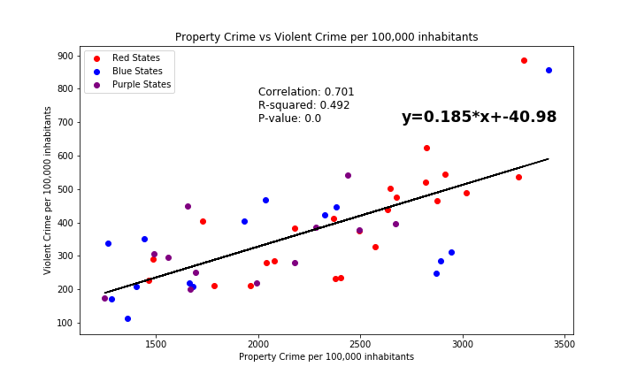
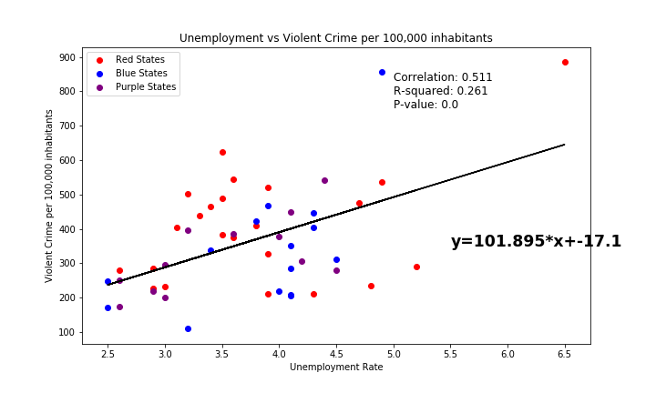
Let’s run a regression analysis for the 50 States
Violent Crime vs. Property Crime…
It may not be the strongest correlation, but there is something to say about the relationship between violent crime rate and property crime rate. They may not rely on one another, but there is a slight connection between the two.
Now this was somewhat of a surprise… We expected to see a correlation between violent crime rate and unemployment rates, however, the positive correlation we notice is weak. There may be a connection, but other aspects are further aiding the rate of violence beyond unemployment rates.
Notes:
Well one thing we can take away is that there is a connection between violent crime rates and property crime rates, however, unemployment does not seem to play the role we thought it did in violent crime rates...or any real roll for that matter.

Slide 13
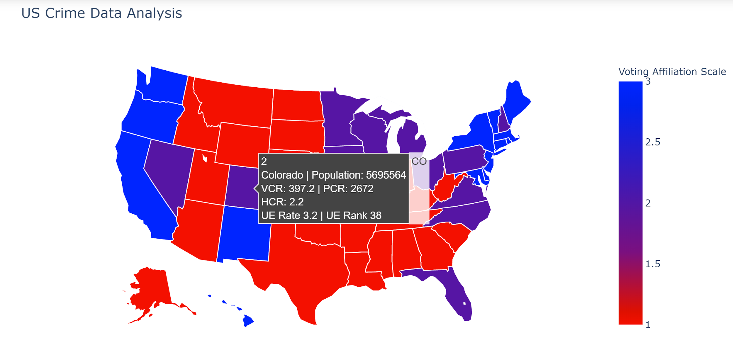
Let’s take a look at the state of Colorado and see if trends differ from US trends
How does an individual state fare?
Notes:
Let’s see if you initial assumptions hold true for a state when broken up by county and whether the trends we saw among the States hold true for the state of Colorado alone.

Slide 14
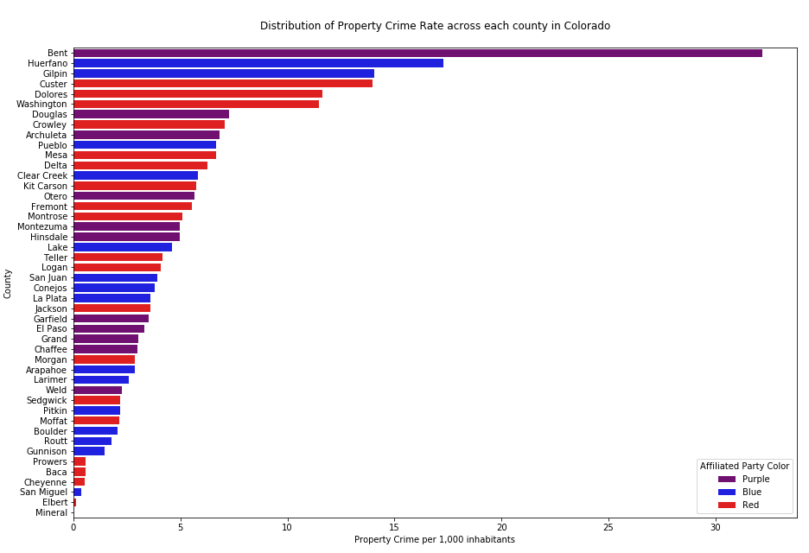
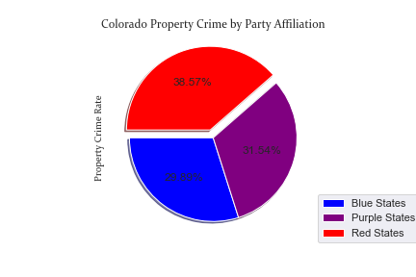
Property crime rates do not tend to sway too much between party affiliations, though we do see red counties having a higher property crime rate, like the US data. Unlike the States data we analyzed, this shows only a slight increase in property crime for red states.
Notes:
The property crime rates across the state of Colorado seem to be evenly distributed across party platforms, as opposed to the US States comparison, as you can note on the pie chart. It is noticeable that one county in particular has an exceptionally high property crime rate, however, party affiliation in this county does not seem to be a factor.

Slide 15
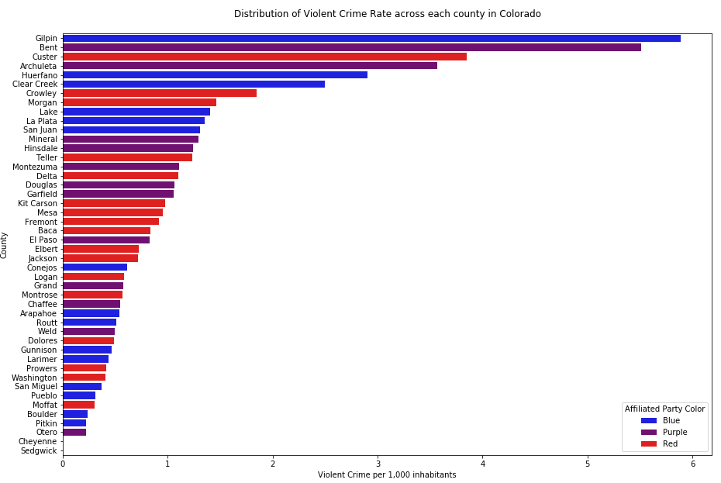
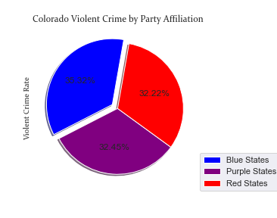
Once again we notice that crime rate do not sway too much between party affiliations, though we do see blue counties having a higher violent crime rate, as was our original assumption. However, the violent crime rates are somewhat evenly distributed among party lines.
Notes:
There does seem to be a slightly higher violent crime rate among Democratic Party favored counties, but not too strong of a difference. Much like the property crime rate (see prior pie chart), the rates for violent crime are somewhat evenly distributed.

Slide 16
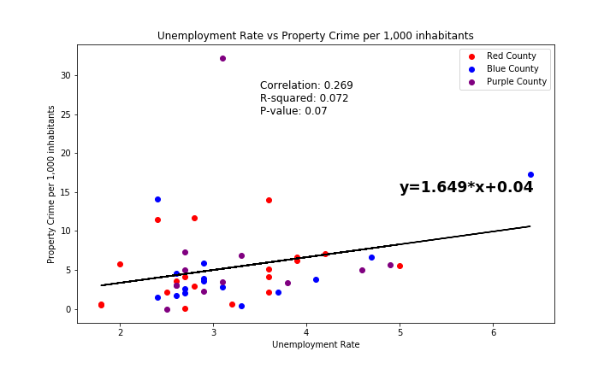
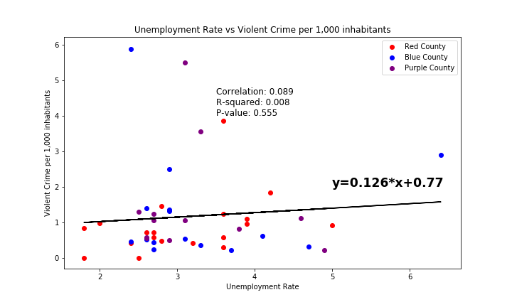
Does Unemployment affect look different for crime rates when comparing an individual state?
It seems that the correlation between unemployment and crime rates among the state of Colorado is very weak, particularly with violent crime. Interestingly enough, even at the state level unemployment does not seem to be a main factor of crime.
Notes:
Once again, our initial hypothesis is proven incorrect when it comes to unemployment and crime rates. We see even less of a connection among the counties in Colorado than among the States.

Slide 17
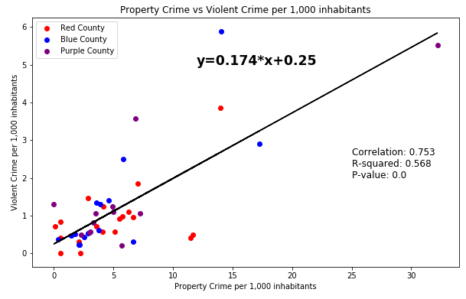
But what about the relationship of crimes?
When we break down the crime rates by county and compare violent crime by property crime we notice a very strong positive correlation. Although we saw a connection among our State data, the relationship between violent crime rate and property crime rates is much stronger when analyzing the state of Colorado.
Notes:
Once again, we notice that there is a strong relationship between violent crime rates and property crime rates.

Slide 18
What can we conclude?
Our analysis did provide us some insight on some of the factors that influence crime rates, however, it also brought forth more questions as we anticipated.
One drawback from our data was that we only analyzed the most recent data available, and while that gave us the most up-to-date information, it also prevented us from mapping trends which could have given our findings more standing.
We did notice that red states, or those who lean Republican, had higher property crime rates (as we predicted) and higher violent crime rates.
When compared to the individual counties in the state of Colorado, this held true only for property crime rates and not nearly as high as among the States.
We found that there is in fact a correlation between violent crimes and property crimes.
we did not find a connection between hate crime rates and violent crime rates
we did notice a suspiciously lacking number of reports among the states with two states not reporting any hate crimes; this may have affected our lack of connection.
There was no strong correlation to crime rates and unemployment rate, to our surprise
.
Notes:
Party Affiliation: We sought out to determine if party affiliation had any connection to crime levels. We anticipated there would be a connection and were correct to a degree.
All in all, we can notice a relationship, but in order to give a more concrete answer towards the association, we would need to break the data down further. Analyzing the voting trends in more depth (i.e. swing state/county that leans democrat, strong republican state/county, swing state/county leans heavily republican etc.) and breaking down each state in more detail would provide more credibility.
Violent and Property Crime connection: We need to understand the way crime works in order to be able to mitigate the issue. Although we may not have come to a decisive conclusion as to why these crime rates are what they are, the connection between the two is still telling; the factor is likely mutual which helps the overall goal of analyzing crime data.
Hate crime does not seem to have any relationship with violent crimes as we initially thought, however, it did educate us in another way; some data may be skewed dependent on outside factors. Hate crime is a biased reporting and the information we receive is dependent on how and who is reporting the data.

Slide 19
Closing statements...
One of our initial questions dealt with an amendment geared toward victims of crimes that differed per state. Although the amendment was not inline with our scope, it is a question we would have liked to have continued with had time and resources permitted.
Drawing further conclusions:
dissecting each state’s trends and voting affiliations
explore unemployment passed state rates
comparing coastal states to non-coastal states
job availability
average pay
cost of living
exploring population in metropolitan areas and non-metropolitan areas
urban and city crime rates
gather state resources and funding
explore the following and note potential correlations with crime rates
unemployed population
workforce commission operations and programs for work preparedeness
homeless population
outreach assistance and funding
individuals needing mental health assistance
program and funding availability
Notes:
One of our initial questions dealt with an amendment that differed per state. The amendment dealt with the victims of violent crimes. It was not directly inline with our core message and question. However, it is one of the continuing factors that could be looked into and used to build upon the data we have and the analysis we completed. We reassessed and decided to go a different route. We also had to know when to drop bad data or data that was missing too much needed information and looked elsewhere.
With more time we would like to dissect the individual states to draw further conclusions like we did with the state of Colorado. Gathering data from past years to gather any possible trends would also be done if more time was given. Additionally, we would like to study unemployment further and maybe delve into unemployment payments per state. With even more time, breaking down state resources for the unemployed population, the homeless population, and those needing mental health assistance and noting any correlation with violent crime rates and property crimes rates while comparing voting trends of those states and counties. Looking to see if there is a noticeable correlation between coastal states and non-coastal states and if job availability as well as income per state and county has any positive or negative effect on crime rates.

Slide 20
Random fun facts
Alaska has the highest crime rate with 885 per 100,000 inhabitants (and the second highest property crime rate)
Maine has the lowest violent crime rate 112 per 100,000 inhabitants
New Hampshire has the lowest property crime rate at 1,249 per 100,000 inhabitants
Hawaii and Vermont have the lowest unemployment rate
Alaska is ranked #1 for unemployment

Slide 21
Q&A...

